Slide 1
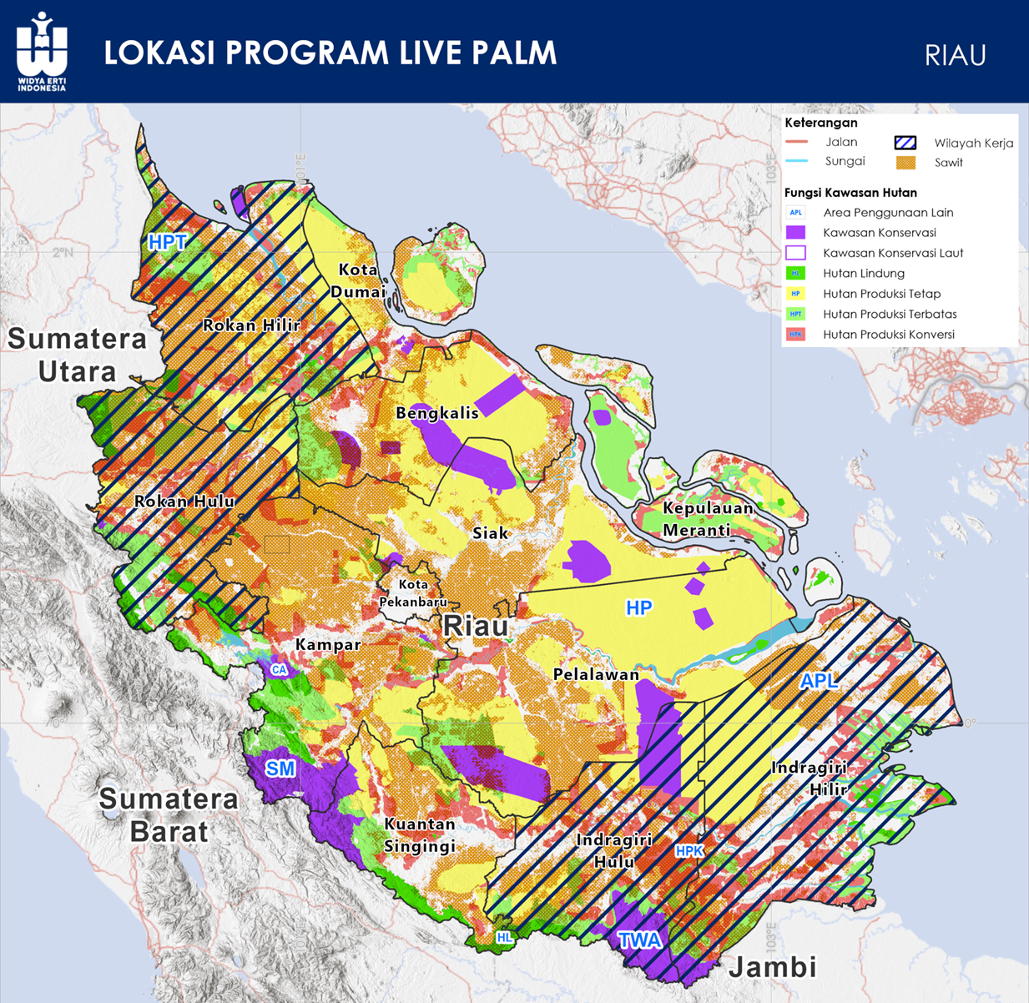
LIVE PALM LOCATION
RIAU
Legend
Road
Project Coverage
River
Oil Palm
Forest Utilization Zone
Other Land Utilization (Non Forest)
Conservation Area
Marine Conservation Area
Protected Forest
Production Forest
Limited Production Forest
Convertible Production Forest

Slide 3
Find an eligible oil palm extent potentials within supply chain catchment
FFB should be transported to mill within 8 hours once it’s harvested to preserve its quality
Oil palm plantation must satisfy these traceability criteria to be eligible as deforestation-free:
Outside forest area
Outside peatland
Outside riparian zone
Comply with the cut-off landuse conversion regulation (November 2005 for RSPO, December 2020 for EUDR)

Slide 4
How do a mill be able to comply with such regulation, and meet its production capacity?
Deforestation free product are meant to premium buyer
Deforestation free products don’t define quality. They promote sustainability by limiting any expansion of forest degradation, which is good.
Good agricultural practice resulting better product quality, tackle any inefficient cost, while promoting sustainability.
All sources of FFB producer must be traced for its eligibility
Any FFB producers that’s not satisfy the criteria are suggested to conduct conservation activity as compensation. If only they insist to access premium buyer.

Slide 5
Accessibility model to nearby oil palm mill
Calculate travel time of every plantation site to nearby mills. Considering transportation modes, road quality, average speed, and barrier.
Depict more realistic extent compared to ring buffer with designated radius.

Slide 6
Accessing eligible oil palm extent
Spatial analysis (AHP/binary)
Data:
Existing oil palm extent (MapBiomass)
Forest/conservation zone (Forestry Government)
Peatland (Forestry Government)
Riparian zone (OpenStreetMap)
Land subject permit (Forestry Government)
Plantation year (Sentinel)

Slide 7
Eligible oil palm within supply catchment
8-10 hours drive catchment area
Eligible oil palm extent
Administrative boundary
Land plot subject

Slide 8
Mill Dominance Rivalry
Mills must meet the daily production capacity to prevent productivity loss
Intersection of supply catchment between nearby mills
Producers tend to look after better price

